Slide 1

Progress Report 4
Applied Language Team
Notes:
Levi

Slide 2
Overview
Accomplishments
Failures
Challenges
Highlights
Goals
Concerns
Notes:
Levi

Slide 3
Accomplishments
What the team accomplished during this time period
Phased implementation plan
Front-end web page edits
Database table creation
Notes:
Levi

Slide 4
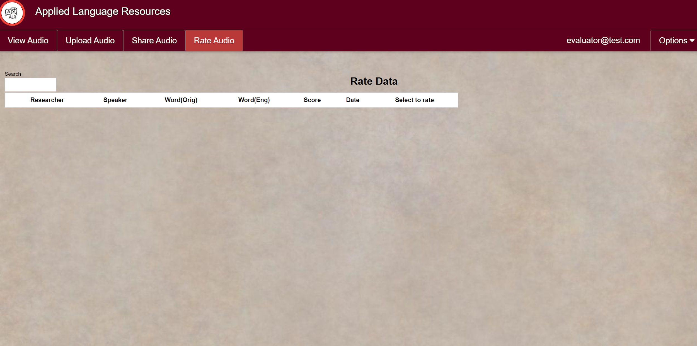
Old Rate Audio Page

Slide 5
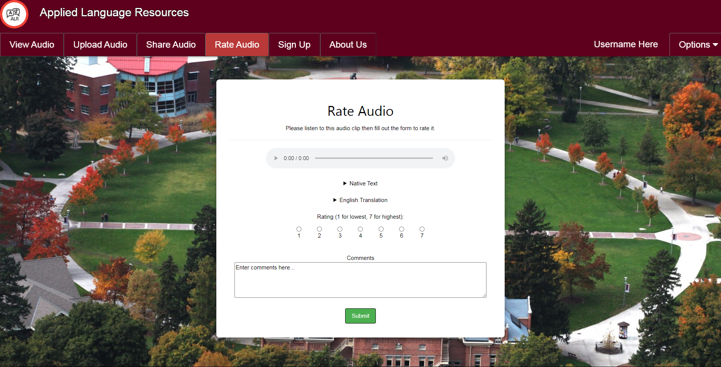
New Rate Audio Page

Slide 6
Failures
What the team planned to accomplish but failed to
Signatures on implementation plan
Notes:
Kobe
largely due to the fact that the assignment of tasks and the estimating of hours took longer than expected, resulting in the plan itself not being in a finalized state until the weekend the plan was due

Slide 7
Challenges
What particular challenges the team faced
Privileged access for server
Notes:
Kobe
We required the ability to start and stop services on the server for basic functionality and updating of the website
We emailed our contact in the school’s IT department, requesting sudo access on the server. The IT department made the necessary changes, and we can now start and stop the web service.

Slide 8
Highlights
What accomplishments the team is most proud of
Communicating well in emails
Team member reliability
Notes:
Kobe
hard work and reliability
deliverables are completed

Slide 9
Goals
What the team will accomplish during the next reporting period
Phase 1 implementation
Continue working on Web pages HTML/CSS
Testing & Gather Feedback on pages
Phase 2 implementation
User Registration (Back-end)
User Confirmation (Back-end)
Notes:
David

Slide 10
Concerns
Any other concerns the team would like to mention
Remaining Django challenges
Notes:
David

Slide 11
Questions?
Notes:
David

